Slide 1

PROGRESS REVIEW 2
AI-Assisted Air Quality Index Analyzer
Department of computer Science & Engineering
CHITKARA UNIVERSITY, HIMACHAL PRADESH
Submitted To: | Submitted By:
Dr. Anshu Sharma Assistant Professor | 1.Vinayak Sharma(2411981621)
 | 2.Varun Singh(2411981616)
 | 3.Tanush Luthra(2411981577)
 | 4.Trijal Wadhwa(2411981588)

Slide 2
AGENDA
Project Overview
Requirement Gathering & Data Collection
Design Phase
Development Kickoff
SDG Goals Mapping
Multidisciplinary Approach
Novelty Factor
Challenges & Risks
References

Slide 3
PROJECT OVERIEW
OBJECTIVES:
Real-Time AQI Data Handling
AI Chatbot for User Interaction
Health and Safety Recommendations
SCOPE:
INCLUDED: 1. Real Time AQI Monitoring
2. Personalized Recommendations
3. Automated Alert System
EXCLUDED: 1. Custom Sensor Development
2. Advanced AI Features and Analytics

Slide 4
STAKEHOLDERS: General Public
TIMELINE:
Month 1 (Planning and Research)
Month 2-3 (Development)
Month 4 (Testing and Refining)
Month 5 (Final Adjustments and Launch)
Month 6 (Deployment and Documentation)

Slide 5
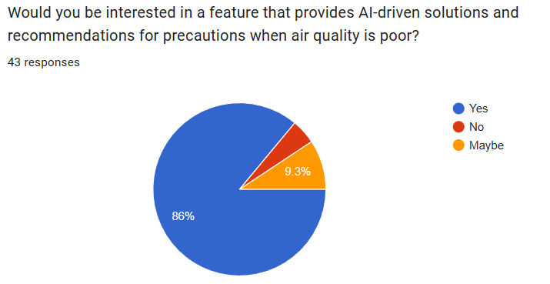
REQUIREMENT GATHERING & DATA COLLECTION
SOURCES OF DATA:
Open Weather API
Surveys

Slide 6
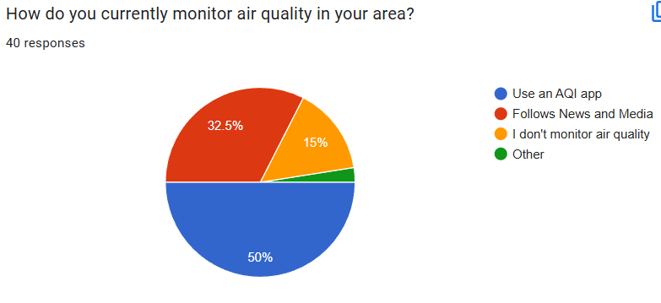
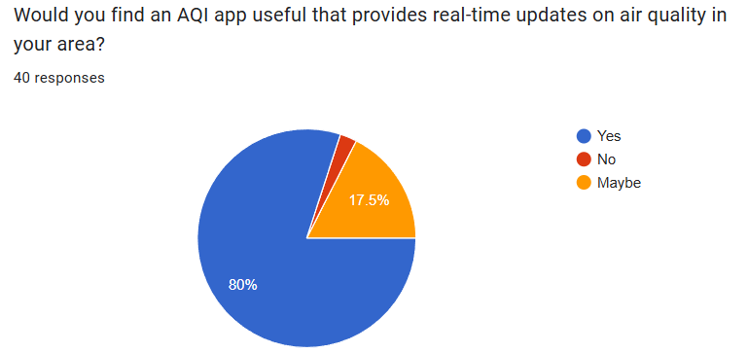

Slide 7
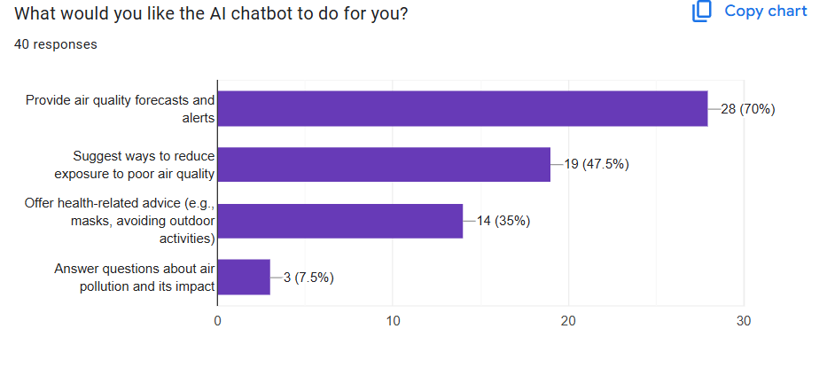
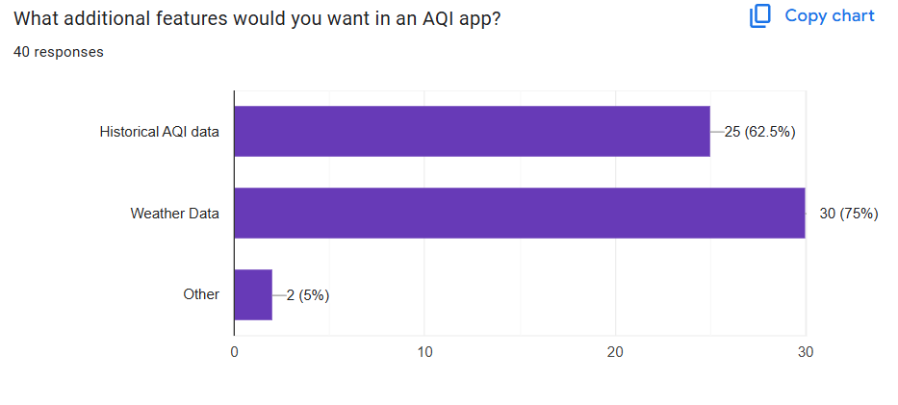

Slide 8
KEY-FUNCTIONAL REQUIREMENTS:
Real-Time Data Integration
Chatbot Interaction
Alert System
NON-FUNCTIONAL REQUIREMENTS:
System Performance and Speed
User-Friendly Interface
Scalability and Growth

Slide 9
CHALLENGES IN DATA COLLECTION:
Data Inconsistency and Accuracy
Geographic Coverage and Accessibility
Data Latency
CURRENT STATUS:
In Progress

Slide 10
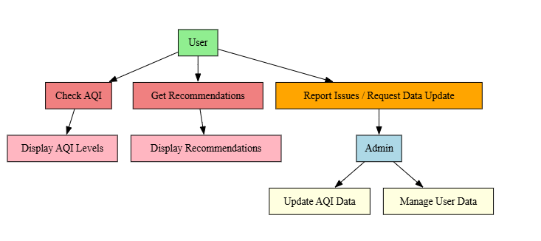
Design Phase
Use Case Diagram

Slide 11
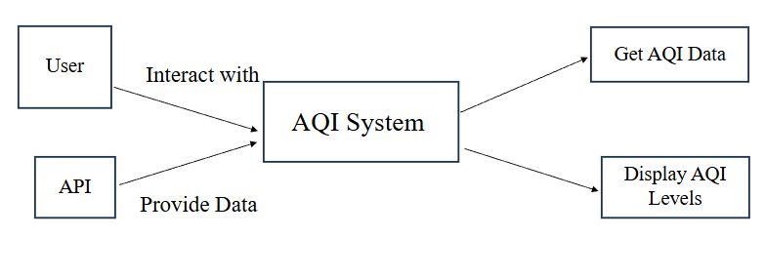
DATA FLOW DIAGRAM:

Slide 12

DEVELOPMENT KICKOFF
PROJECT STRUCTURE AND SETUP:
Folder Organization:
index.html - The main HTML file for the web application.
styles.css - External stylesheet for all page styles.
scripts.js - JavaScript file for handling functionality and interactivity.

Slide 13
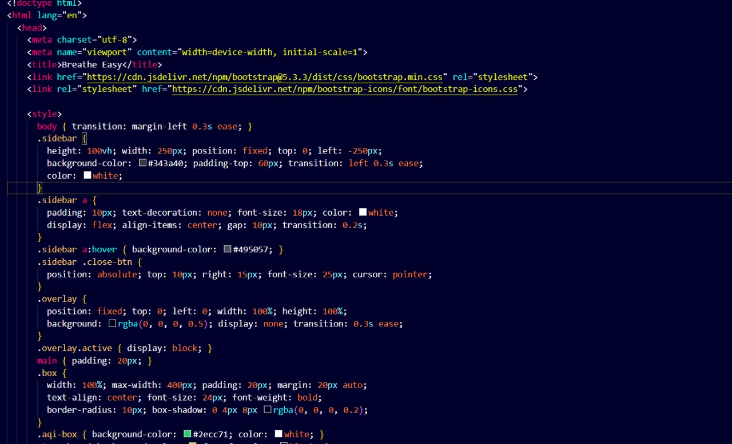
INITIAL CODE SETUP

Slide 14
SDG GOALS MAPPING
SDG 3: Good Health and Well-being: Provides real-time AQI data to help protect public health from air pollution.
SDG 11: Sustainable Cities and Communities: Supports urban sustainability by tracking air quality in cities.
POTENTIAL IMPACT:
Raises Awareness
Promotes Healthier Lifestyles
Encourages Sustainability

Slide 15
CONTRIBUTION TO SOCIAL GOOD:
Equity in Access: Ensures access to air quality data for all, especially in high-risk areas.
Prevention of Health Issues: Reduces the risk of diseases related to poor air quality by promoting awareness and preventative measures.

Slide 16
MULTIDISCIPLINARY APPROACH
FIELDS INVOLVED:
Data Collection
Predictive Analytics
Front-End Development
Chatbot Integration
TEAM COLLABORATION:
Coordinated Effort
Problem Solving

Slide 17
INTERDISCIPLINARY INNOVATION:
AI & Data Integration
Optimized User Experience
Software Engineering
Data Analytics

Slide 18
NOVELTY FACTOR
WHAT MAKES OUR PROJECT UNIQUE?
AI-Powered Chatbot Integration
Real-Time Interaction
COMPARISON WITH EXISTING SOLUTIONS:
Traditional AQI Tools: Most existing AQI tools display data without much interaction or personalization. They provide static readings and basic information.
Our Solution: Offers real-time, interactive responses via the AI chatbot and personalized recommendations based on individual locations and health factors.

Slide 19
INNOVATION IN APPROACH, DESIGN OR TECHNOLOGY:
AI Chatbot for Personalized User Experience: Innovation in utilizing NLP (Natural Language Processing) to offer a conversational interface that answers questions and provides advice based on the user’s needs.
Predictive Analytics: Leverages machine learning models to predict air quality trends, empowering users to plan ahead and take action before poor air quality becomes a problem.

Slide 20
CHALLENGES & RISKS
KEY CHALLENGES FACED SO FAR:
Data Accuracy and Reliability: Ensuring that AQI data from various sources (e.g., sensors, APIs) is accurate, real-time, and reliable.
Integrating AI Chatbot with Data: Developing a functional AI chatbot that understands and responds appropriately to user queries while integrating seamlessly with the real-time AQI data.
IDENTIFIED RISKS & STRATEGIES:
Risk : Inaccurate or Incomplete data.
Data Mitigation: Use multiple trusted data sources and regularly validate data for accuracy. Implement data correction mechanisms if inconsistencies are detected.

Slide 21
Next Steps
FINALIZING DESGIN PHASE:
Chatbot Interaction Flow: Perfect the chatbot conversation design to ensure smooth and relevant interactions.
Visual Design: Ensure the design is visually appealing, with clear representation of AQI data and alerts in a user-friendly format.
EARLY DEVELOPMENT & TESTING:
Core Features Development: Start building the main features, including data integration, real-time AQI updates, and the AI chatbot functionality.

Slide 22
REFERENCES
Agache, I., Annesi‐Maesano, I., Cecchi, L., Biagioni, B., Chung, K.F., Clot, B., D'Amato, G., Damialis, A., Del Giacco, S., Dominguez‐Ortega, J. and Galàn, C., 2024. EAACI guidelines on environmental science for allergy and asthma: The impact of short‐term exposure to outdoor air pollutants on asthma‐related outcomes and recommendations for mitigation measures. Allergy, 79(7), pp.1656-1686. EAACI guidelines on environmental science for allergy and asthma: The impact of short‐term exposure to outdoor air pollutants on asthma‐related outcomes and …
Agache, Ioana, et al. "EAACI guidelines on environmental science for allergy and asthma: The impact of short‐term exposure to outdoor air pollutants on asthma‐related outcomes and recommendations for mitigation measures." Allergy 79.7 (2024): 1656-1686. 'Real-time'air quality channels: A technology review of emerging environmental alert systems

Slide 23
Kang, G.K., Gao, J.Z., Chiao, S., Lu, S. and Xie, G., 2018. Air quality
prediction: Big data and machine learning approaches. Int. J. Environ. Sci.
Dev, 9(1), pp.8-16.
Air quality prediction: Big data and machine learning approaches
Abulude, F.O., Oluwafemi, M.O., Arifalo, K.M., Elisha, J.J. and Yusuf, A., 2022. Real-time air quality index app: The use of eWeather HDF App for education in monitoring of pollutants and meteorological parameters in Nigeria. ASEAN Journal of Science and Engineering Education, 2(2), pp.157-162. Real-time air quality index app: The use of eWeather HDF App for education in monitoring of pollutants and meteorological parameters in Nigeria

Slide 24
THANK YOU

